Slide 1
Course: Classical Physics for Engineers
Unit 1 : Oscillations
Motion of bodies can be broadly classified into three categories:
Translational motion
Rotational motion
Vibrational / Oscillatory motion
When a body executes back and forth motion which repeats over and again about a mean position, then the body is said to have Vibrational/oscillatory motion. If such motion repeats in regular intervals of time then it is called Periodic motion or Harmonic motion and the body executing such motion is called Harmonic oscillator.
In harmonic motion there is a linear relation between force acting on the body and displacement produced.
If there is no linear relation between the force and displacement then the motion is called un harmonic motion. Many systems are un harmonic in nature

Slide 2

1. Mean position: The position of the oscillating body at rest.
2. Amplitude: The amplitude of an SHM is the maximum displacement of the body from its mean position.
3. Time Period: The time interval during which the oscillation repeats itself is called the time period. It is denoted by T and its unit in seconds.
4. Frequency: The number of oscillations that a body completes in one second is called the frequency of periodic motion. It is the reciprocal of the time period T and it is denoted by f
Frequency f=1/T
5. Angular frequency: This is the orbital frequency or circular frequency and it is measured in radians per second. It is denoted by ω
ω = 2п x 1/T = 2пf
6. Phase: It is the stateof an oscillating system. If the SHM is represented by y=A sin (ωt+ ), together with ω as the angular frequency. The quantity (ωt+φ ) of the sine function is called the total phase of the motion at time ‘t’ and ‘φ ’ is the initial phase or epoch.

Slide 3
Simple harmonic Motion (SHM)
A body is said to be undergoing Simple Harmonic Motion (SHM) when the acceleration of the body is always proportional to its displacement and is directed towards its equilibrium or mean position.
A particle or a system which executes simple harmonic motion is called Simple Harmonic Oscillator.
Linear Simple Harmonic Motion: If the body executingSHM has a linear acceleration then the motion of the body is linear simple harmonic motion.
Examples: motion of simple pendulum, the motion of a point mass tied with a
spring etc.,
Angular Simple Harmonic Motion: If the body executing SHM has an angular acceleration then the motion of the body is angular simple harmonic motion.
Examples: Oscillations of a torsional pendulum

Slide 4
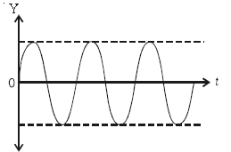
Free vibrations or Un damped vibrations
If a body oscillates without the influence of any external force, then the oscillations are called free oscillations or un damped oscillations.
In free oscillations the body oscillates with its natural frequency and the amplitude remains constant.

Slide 5
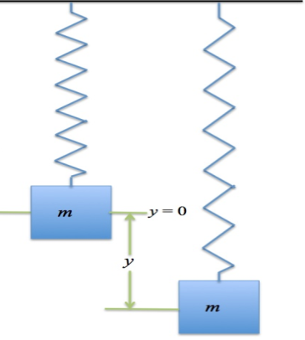
Examples of Simple harmonic oscillator
The spring and mass system is an example for linear simple harmonic oscillator.
The spring mass system consists of a block of mass m suspended from a rigid support by means of a mass less spring (ie a spring whose mass is negligible).
According to Hooke’s Law “The restoring force produced in a system is proportional to the displacement”. When the mass is displaced through a distance ‘y’then the restoring force (F) produced is
F α y
F = −ky--------- (1)
The constant k is called force constant or spring constant or stiffness constant.
Spring constant is the measure of the stiffness of the spring.
-ve sign denotes the restoring force is opposite to the direction of applied force.

Slide 6
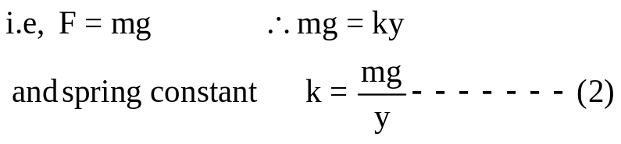
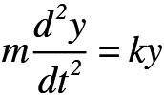
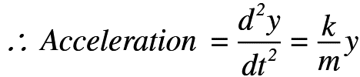
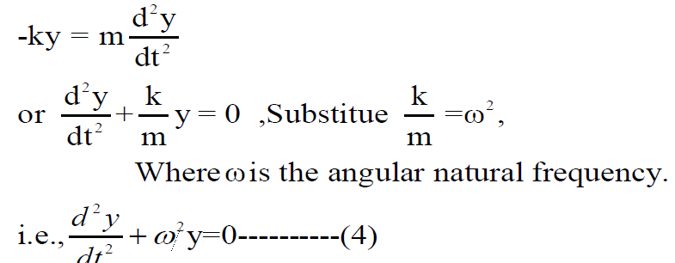
In equilibrium condition the linear restoring force (F) in magnitude is equal to theweight ‘mg’ of the hanging mass.
Now, if the mass is displaced down through a distance ‘y’ from its equilibrium position and released then it executes oscillatory motion.
From Newton’s second law of motion for the block we can write
                t
Th
This is the differential equation for free
oscillator

Slide 7
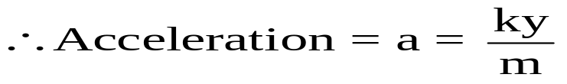
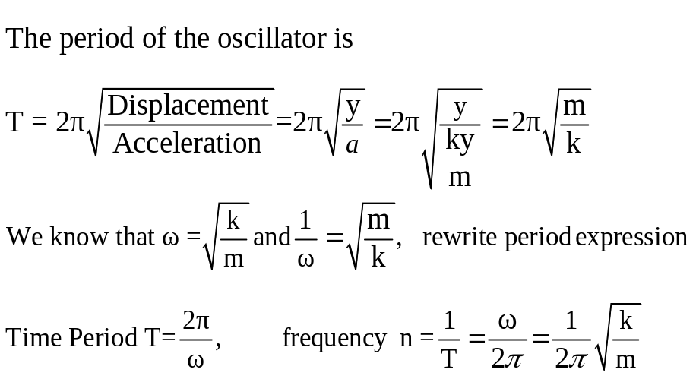
Period of the oscillator (T)
We have F = ma and also F = -ky.
At equilibrium, magnitude of restoring force is equal to weight of hanging mass.
i.e, ma = ky

Slide 8
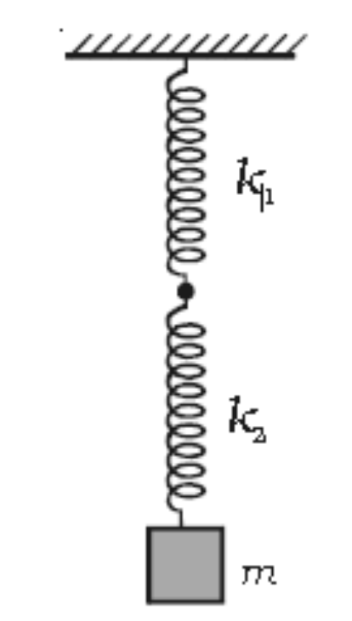

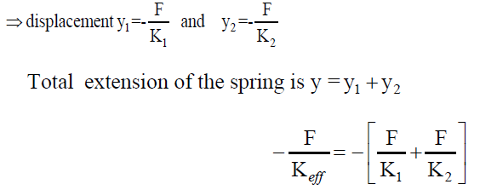
Spring Constant in Series and Parallel combination Springs in Series
Consider two springs K1 and K2 be connected in series and a mass ‘m’ to the lower end of the bottom most spring.
Let ‘y’ is the displacement of mass m at any time when mass ‘m’ is pulled down and
released.
Let y1 and y2 be the extension of two springs
The total extension of the spring system is
In series restoring force in each spring is same.
Then

Slide 9
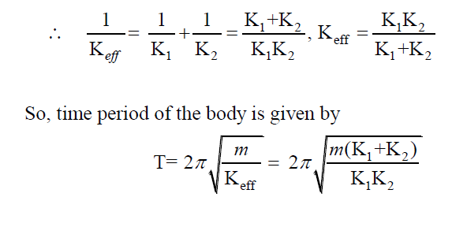

Slide 10
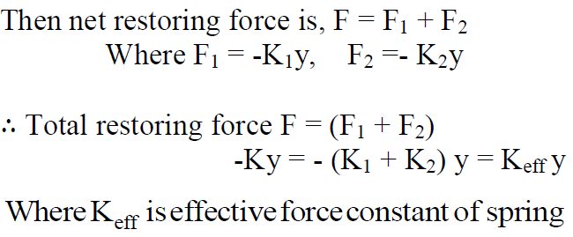
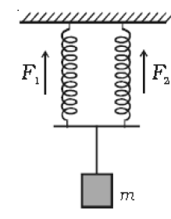
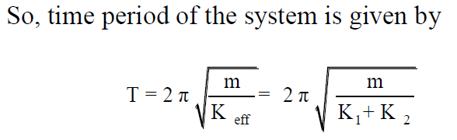
Springs in Parallel
Consider two springs A and B of force constants K1 and K2 be connected in parallel and a mass ‘m’ is attached at the lower end as shown in the figure 4. Let mass ‘m’ be pulled a little and released. Let ‘y’ be the displacement of mass ‘m’ from equilibrium position. Let F1 and F2 be the restoring forces developed in springs A and B respectively.

Slide 11
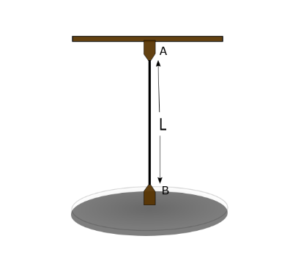
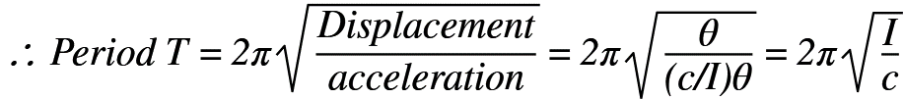
Torsion Pendulum:
A pendulum in which the oscillations are due to the torsion (or twist) is a torsion pendulum.
If θ is the angle of twist in the wire and ‘C’ is the couple per unit twist for the wire, then the restoring couple = Cθ.
At any instant, the deflecting couple (Iα) is equal to the restoring couple,
(where I is the moment of inertia of the wire about the axis and α is the angular acceleration).
I α= -Cθ ……………..(1)
α =- (C/I)θ …..(2)

Slide 12
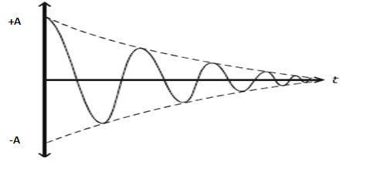
Damped oscillation (vibration)
The vibrations which are subjected to external opposing force are called damped vibrations.
If a body set into vibrations, its amplitude will be continuously decreasing due to friction/resistance

Slide 13
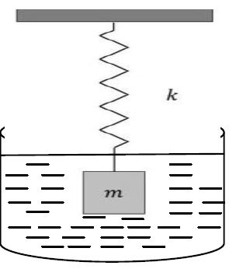
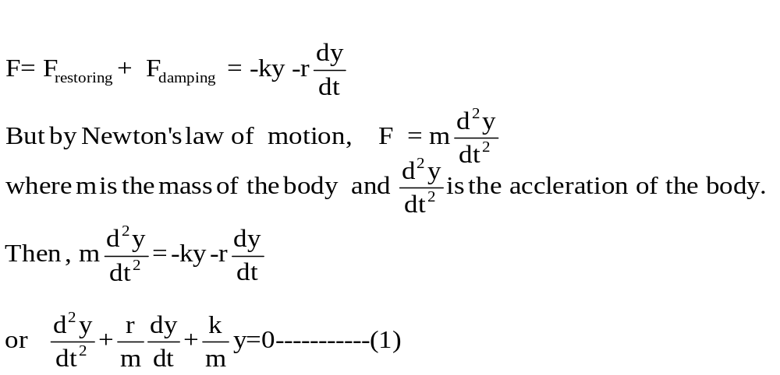
Differential equation of damped vibrations and solution
If y is the displacement of the body from the equilibrium state at any instant of time ‘t’, then dy/dt is the instantaneous velocity and d²y/dt² is the acceleration.
At any instant the two forces acting on the body are:
A restoring force which is proportional to displacement and acts in the opposite
direction, it may be written as
F_{restoring}= −ky Where k is the spring constant
A frictional or damping force which is directly proportional to the velocity of the mass and is opposite to the motion, it may be written as
The net force acting on the oscillator is the summation of the two.
This is the

Slide 14

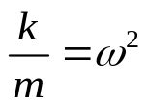
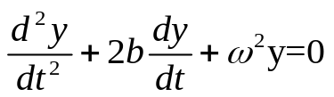

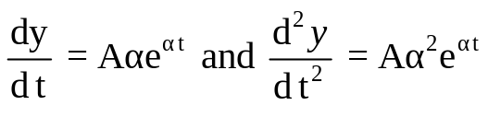
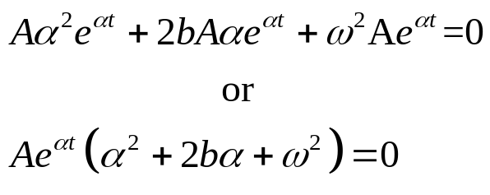
Let = 2b, and
Then This is the differential equation of second order. ---- (2)
In order to solve the equation, let us assume the solution of the form
-------- (3)
Where A and α are 2 arbitrary constants (variational parameters). Differentiating equation (3) with respect to time t, we have
By substituting these values in equation (2), we have

Slide 15

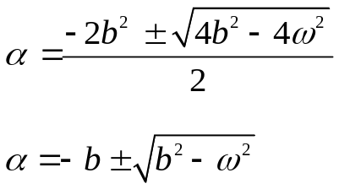
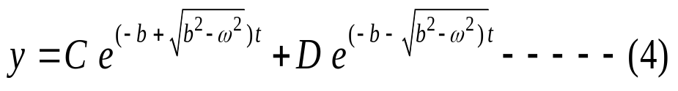
For the above equation to be satisfied, either y=0 or
Considering the solution
The standard solution of the above quadratic equation has two roots, it is given by,
Therefore, the general solution of equation (2) is given by

Slide 16

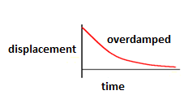
is real and less than b, Hence in above equation exponents are negative. It means the displacement decreases continuously with time.
i.e particle once displaced will return to its mean position without performing oscillation. Such motion is called over damping or aperiodic motion
Eg:- pendulum moving in thick oil or by a deadbeat moving coil galvanometer.

Slide 17
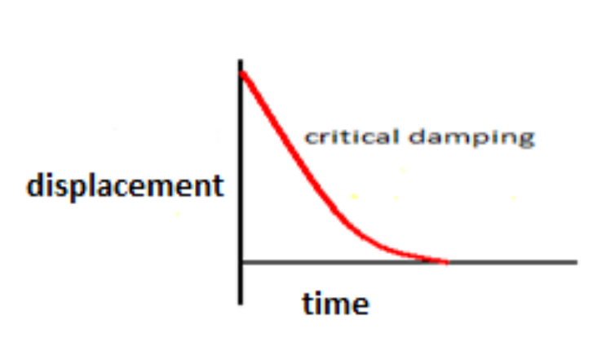


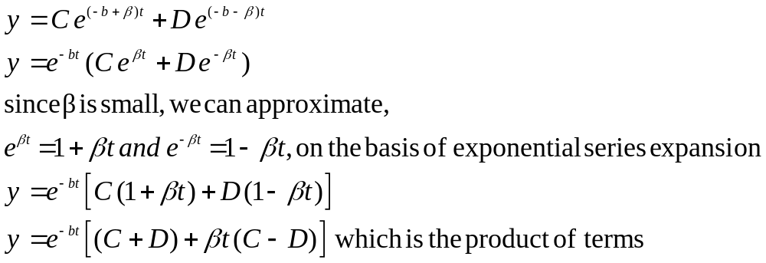


For the solution of 4 does not satisfy the equation 2.
Hence, consider is small nonzero quantity β
As‘t’ is present in (dominant) and also in the term both of them contribute to the variation of y with respect to time.
y decreases throughout with increase of t, the decrement is slow in the beginning, and then decreases rapidly to approach the value zero. i.e., the body attains equilibrium position (Fig.9). Such damping motion of a body is called critical damping.
Eg: voltmeter, ammeter, spring system in automobiles

Slide 18

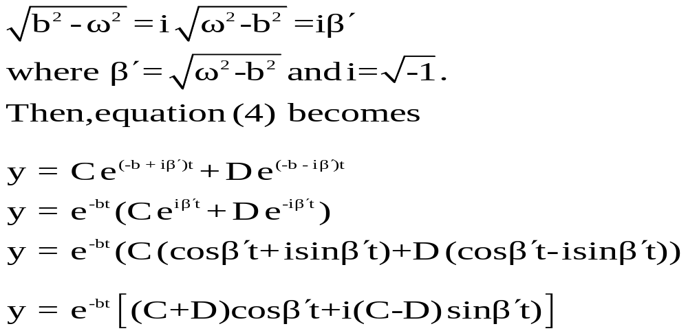
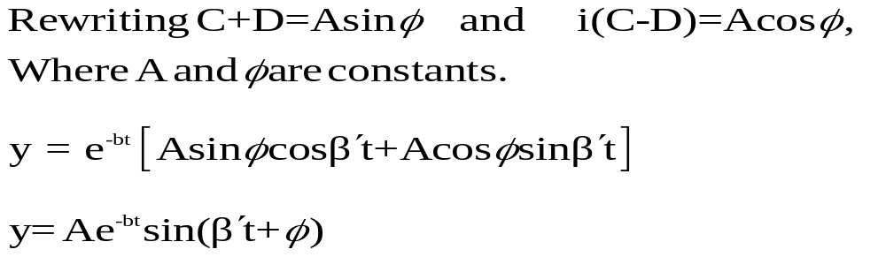
In this case is imaginary.
Let us write
represents displacement in the damped harmonic oscillations.

Slide 19
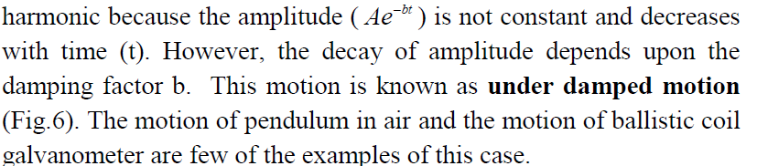
Oscillations are not simple harmonic because

Slide 20
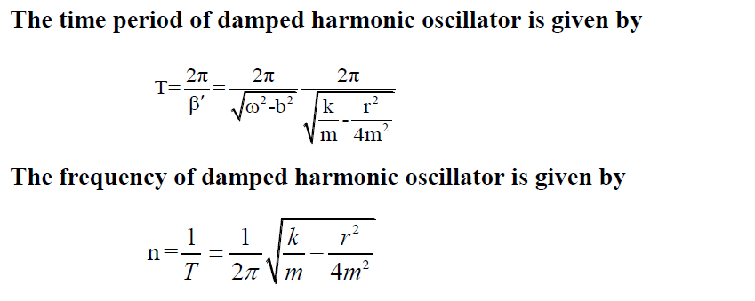

Slide 21
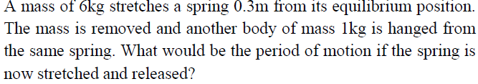
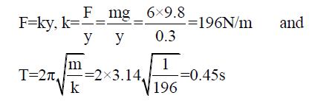

Slide 22
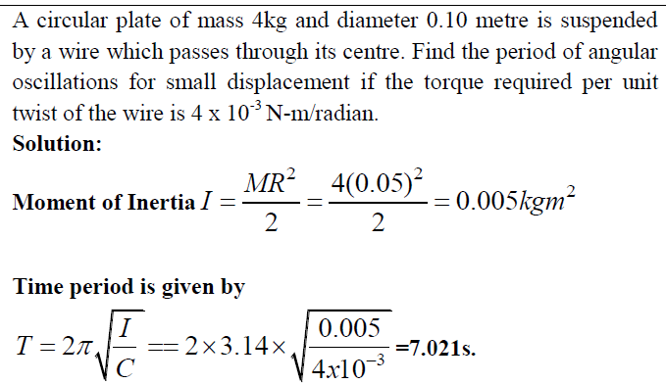

Slide 23


Forced Vibration
The vibrations in which the body vibrates with frequency other than natural frequency of the body, and they are due to applied external periodic force.
Differential equation of forced vibrations and solution
Consider a particle of mass m is connected to a spring. When it is displaced and released it starts oscillating about a mean position. The particle is driven by external periodic force
F_{restoring}= -ky
F _{damping} = where, r is frictional force or unit velocity
Applied force where, Fo is maximum value of the force, ω_{d} is the angular frequency of the driving force.

Slide 24
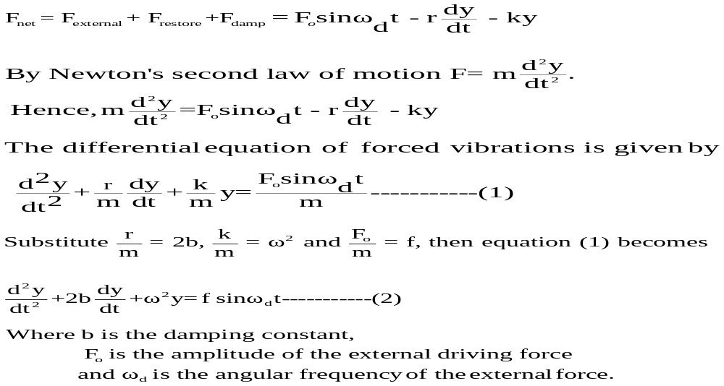
The total force acting on the particle is given by,

Slide 25

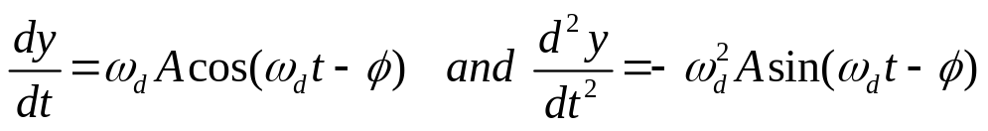
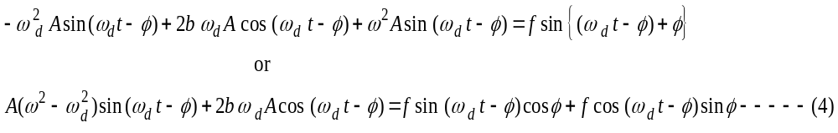
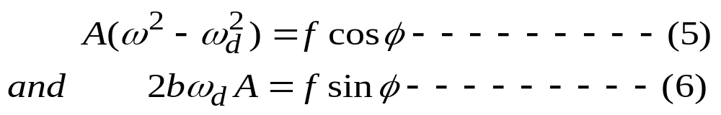
Let the solution of the above equation is of the form
represent the SHM and ω_{d} and Φ represetns amplitude and phase of oscillatory body respectively.
Differentiate above equation w.r.t ‘t’ twice
By substituting the values of y, dy/dt and d²y/dt² in the differential equation of the forced oscillations , we get
If equation (4) holds good for all values of t, then the coefficients of sin (ω_{d}t- φ) and cos(ω_{d}t- φ) must be equal on both sides, then

Slide 26
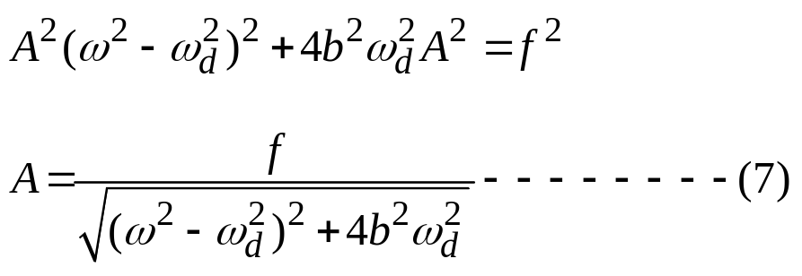
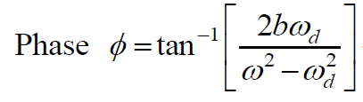
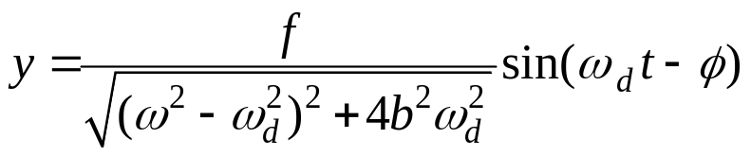
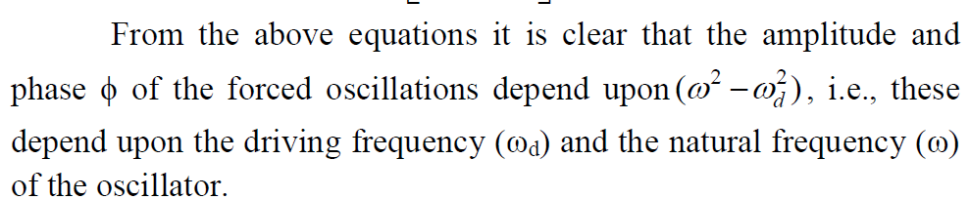
By squaring and adding equations (5) and (6), we have
By dividing equation (6) by (5), we get

Slide 27
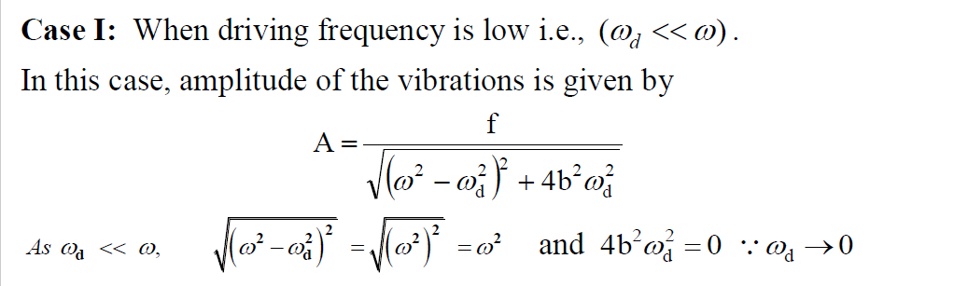
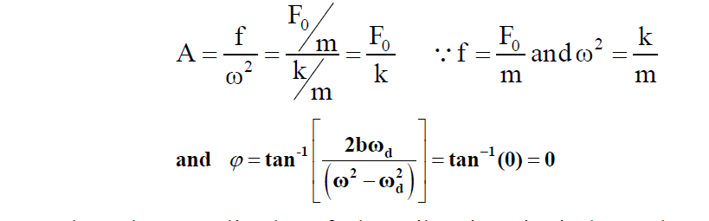
This shows that the amplitude of the vibration is independent of frequency of the driving force and is dependent on the magnitude of the driving force and the force-constant (k). In such a case the force and displacement are always in phase.

Slide 28
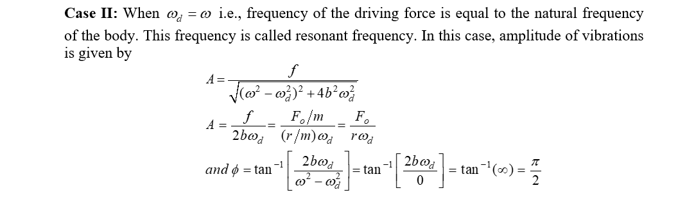
The amplitude of the vibrations becomes maximum and is inversely proportional to the damping coefficient. For small damping, the amplitude is large and for large damping, the amplitude is small. The displacement lags behind the force by a phase π/2.

Slide 29
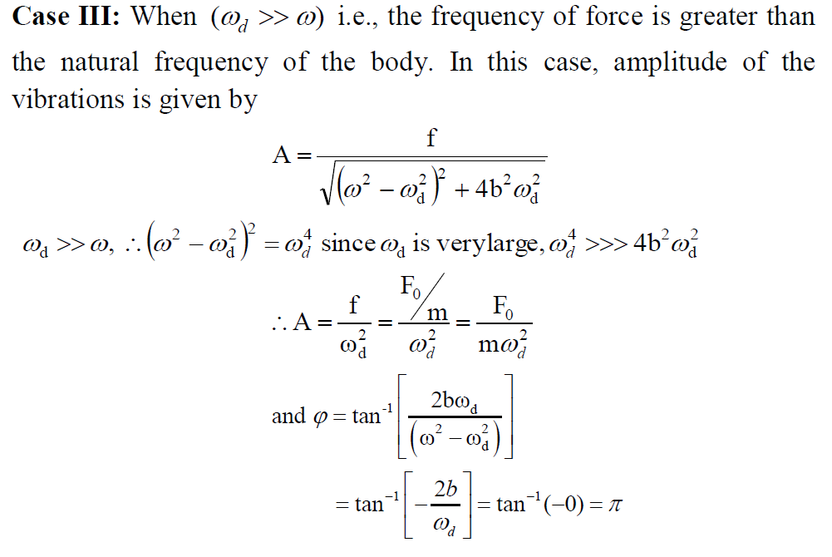
The amplitude depends on the mass and continuously decreases as the driving frequency ω_{d} is increased and phase difference towards π.

Slide 30
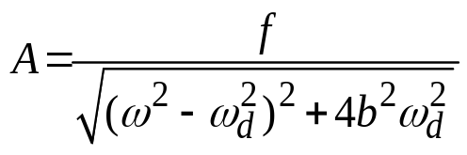

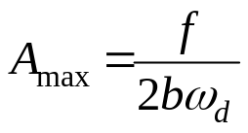
Resonance:
Resonance is a phenomenon in which a body vibrates with its natural frequency with maximum amplitude under the influence of an external vibration with the same frequency.
Condition of amplitude resonance: The phenomenon of amplitude becoming a maximum is known as amplitude resonance.
is the amplitude of forced oscillation
At resonance,
i.e.
If the damping is small i.e., b is small, the condition of maximum amplitude reduced

Slide 31
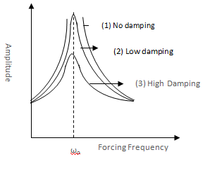
Sharpness of the resonance.
Sharpness of resonance can be defined as the rate of fall in amplitude, with respect to the change in forcing frequency on either side of the resonant frequency.
It can be seen that the resonant peak moves towards the left as the damping factor is increased. It is also observed that the value of amplitude, which is different for different values of b (damping), diminishes as the value of b increases.

Slide 32





3) A particle executes SHM of period 31.4 second and amplitude 5cm. Calculate its maximum velocity and maximum acceleration.
Solution:
The maximum velocity at y =0 in (Obtained from equation of free oscillation y=A sin ωt
v_{max}=
maximum acceleration is

Slide 33



4) In spring-mass systems shown in the figure, $k_{1}$= 2000 N/m, $k_{2}$ = 1500 N/m, $k_{3}$ = 3000 N/m, $k_{4}$= $k_{5}$ = 500 N/m. Find m such that the system has a natural frequency of 10 Hz in each of the cases.
m = 0.1 kg
f = $\frac{1}{2π}\sqrt{k/m}$

Slide 34



5) Calculate the peak amplitude of vibration of a system whose natural frequency is 100 Hz when it oscillates in a resistive medium for which the value of damping/unit mass is 0.008 rad/s under the action of an external periodic force / unit mass of amplitude 5 N/kg, with tunable frequency.
Given:
Natural frequency υ = 1000 Hz
Daming /unit mass (r/m)= 0.008 rad/s
Amplitude of applied force/unit mass (F/m = N/kg
We have 2b = $\frac{r}{m}$
b = 0.004
At maximum amplitude,
A max = 0.1 m

Slide 35

6) A 20 gm oscillator with natural angular frequency 10 rad/second in damping medium. The damping force is proportional to velocity of the vibrator. If the damping coefficient id 0.17, how does the oscillations decay?
Given:
Mass of the oscillator, m = 20 gm = 0.2 kg
Natural angular frequency ω = 10 rad/second
Damping force α (dy/ dt)
Damping coefficient, r = 0.17 kg/s
b = 4.25
ω = 100
Here $b^{2}$ < $ω^{2}$
Underdamping

